Slide 1

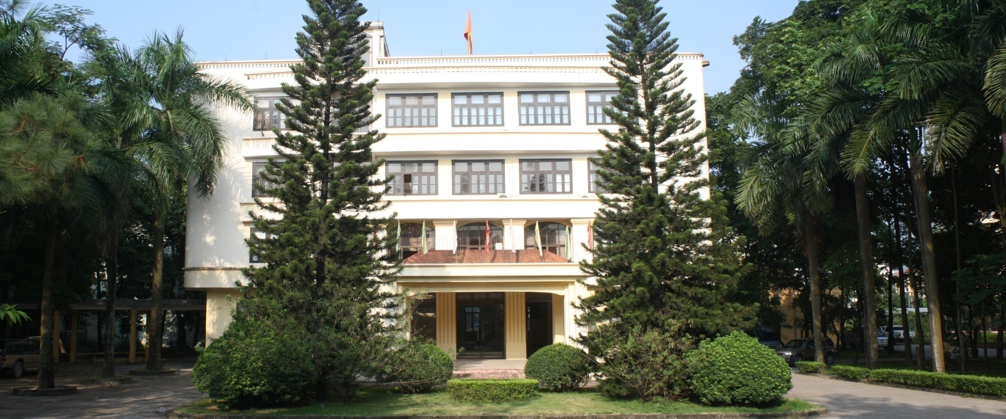
Vietnamese Academy of Forest Sciences (VAFS)
TECHNIQUES AND RESULTS OF AGARWOOD REPOPULATION
IN VIET NAM (on going project)

Slide 2
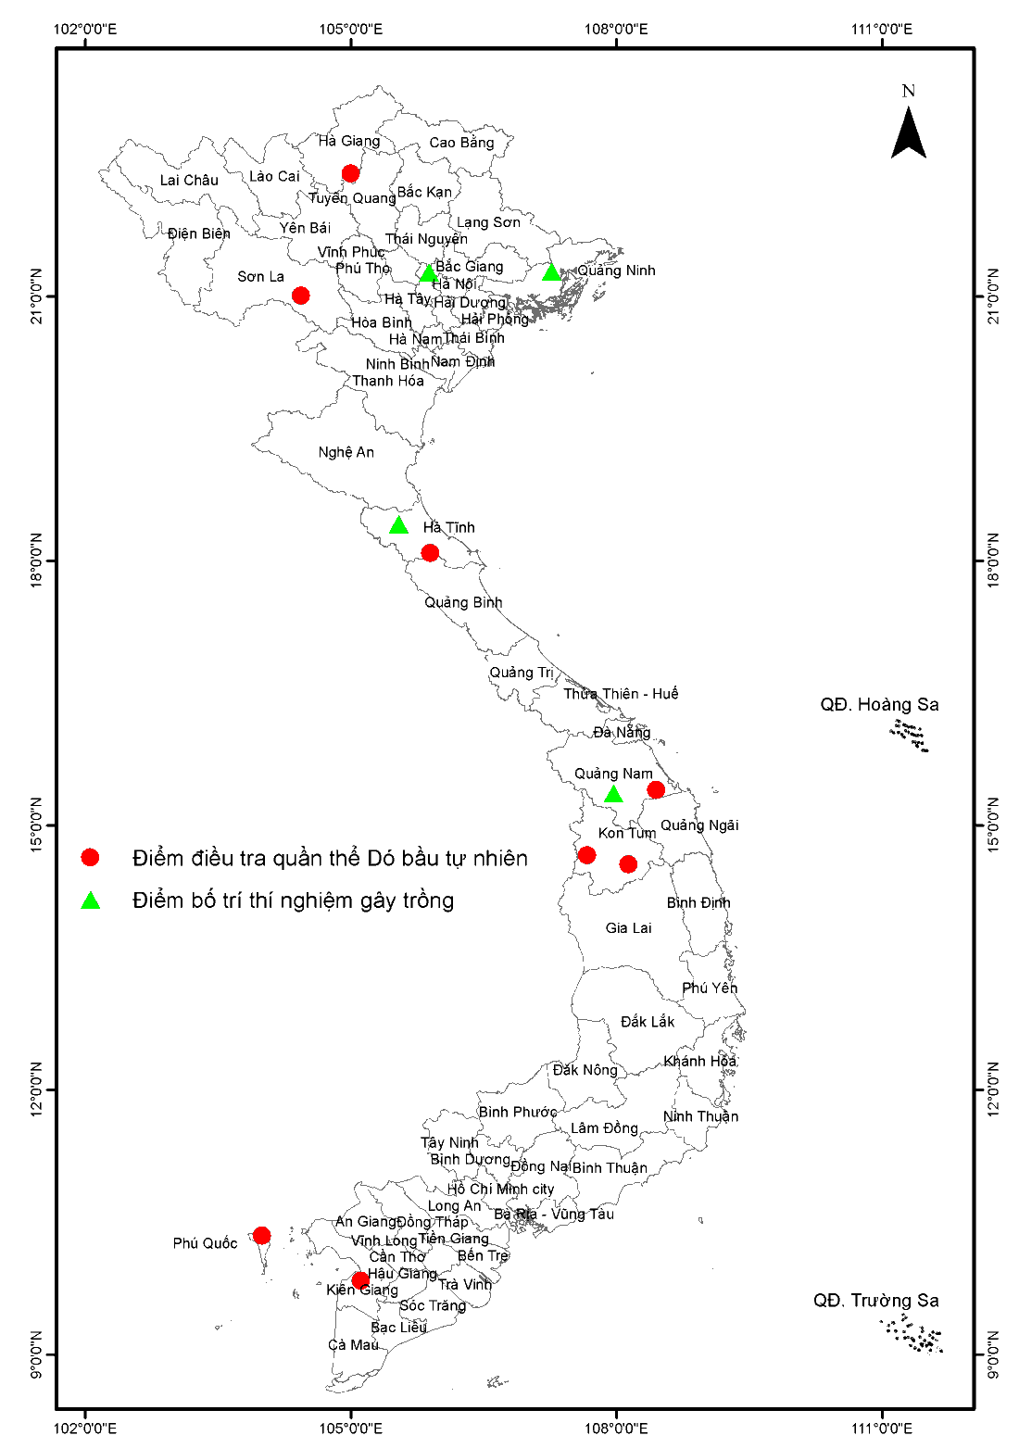

Species, distribution and plantation
Species: 24 species in genus Aquilaria (CITES)
4 species in genus Aquilaria (Vietnam)
Distribution: Tropical countries in Asia, Africa,
and Australia (Major)
Whole country in Vietnam
Natural distribution
Plantation
Plantation: almost in Asian countries include: China, Taiwan, Malaysia, Indonesia, Thai Lan, India, Philippine, Vietnam.
~ 12,000 ha (A. crassna) in Vietnam
(trial forest, mixed forest and pure forest)
Vietnamese Academy of Forest Sciences (VAFS) www.vafs.gov.vn

Slide 3
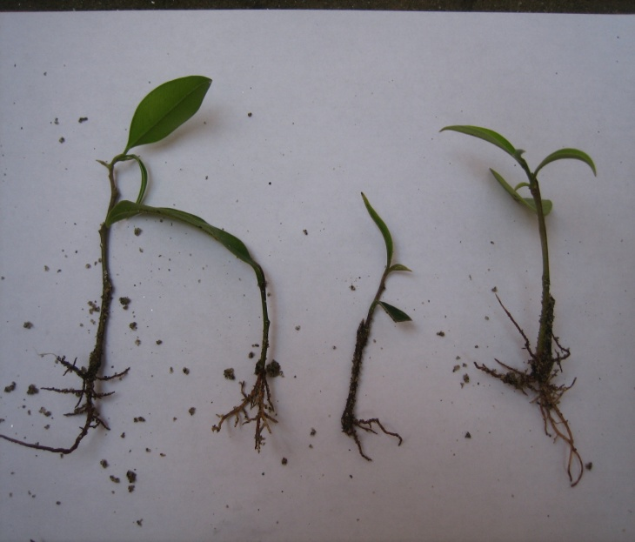
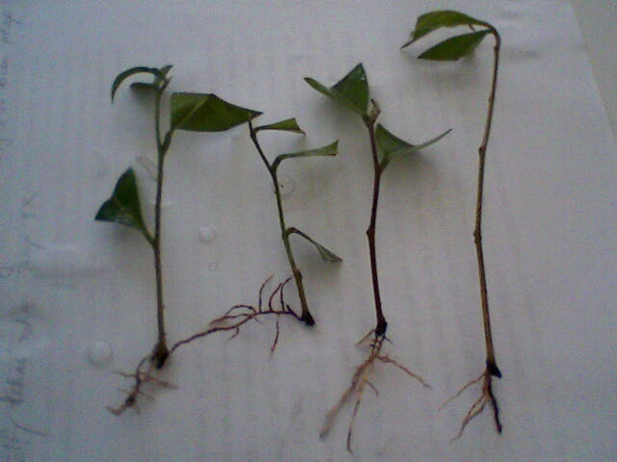








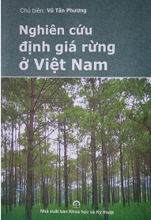

Vegetative propagation
(Aquilaria crassna)
Rooting percentage (Cutting):
Concentration | Rooting hormone
 | IAA | IBA | NAA
1000ppm | 11,33 | 19,33 | 16,67
1500ppm | 33,33 | 61,33 | 40,00
2000ppm | 25,33 | 28,00 | 27,33
Mother tree age | Rooting percentage
1 | 60,83
5 | 59,17
10 | 4,17
12 weeks
Vietnamese Academy of Forest Sciences (VAFS) www.vafs.gov.vn

Slide 4
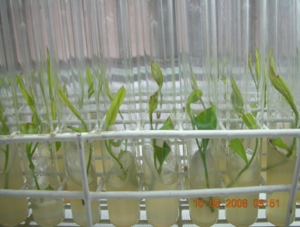
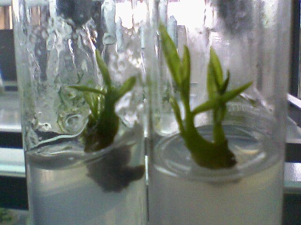
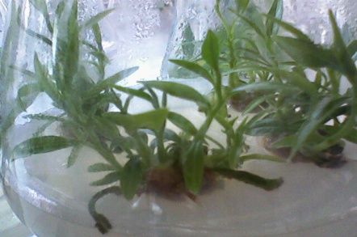
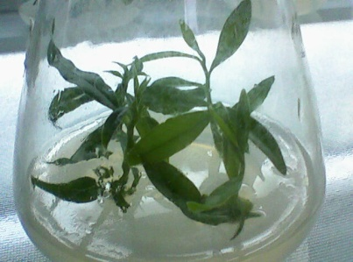
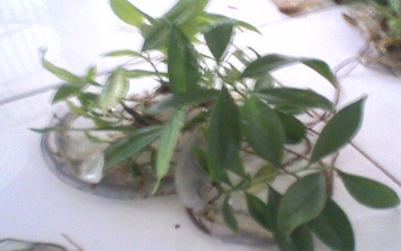
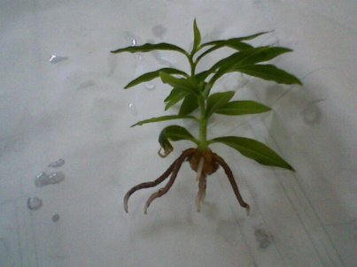
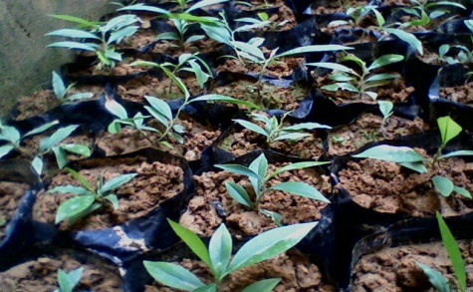
Tissue culture
24 weeks
Vietnamese Academy of Forest Sciences (VAFS) www.vafs.gov.vn

Slide 5
Shading in nursery
50 % shading in nursery
No shading 25% 50% 75%
No shading 25% 50% 75%
Survival rate (%)
Height (cm)
Vietnamese Academy of Forest Sciences (VAFS) www.vafs.gov.vn

Slide 6
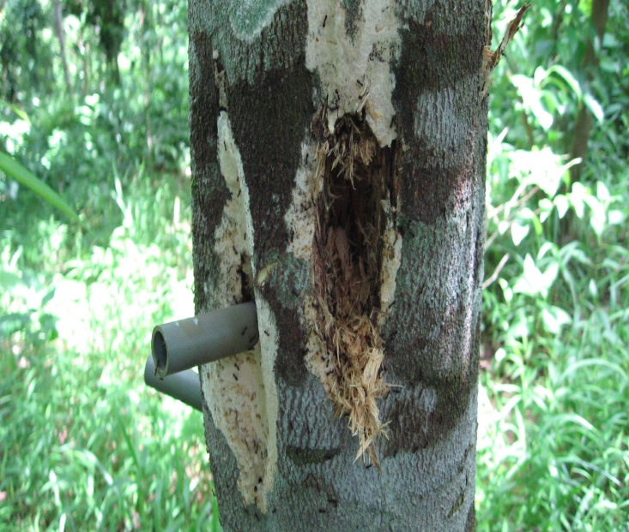
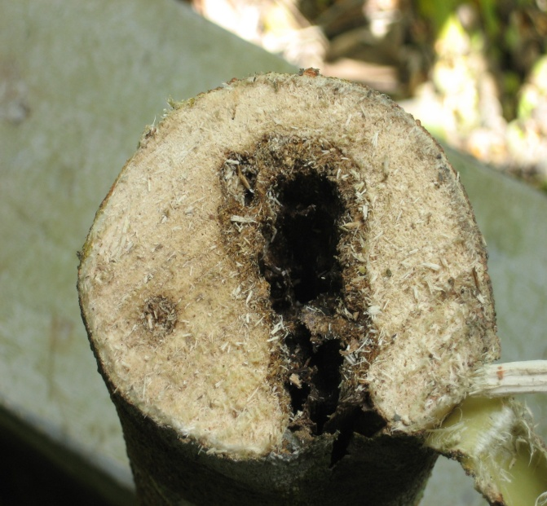
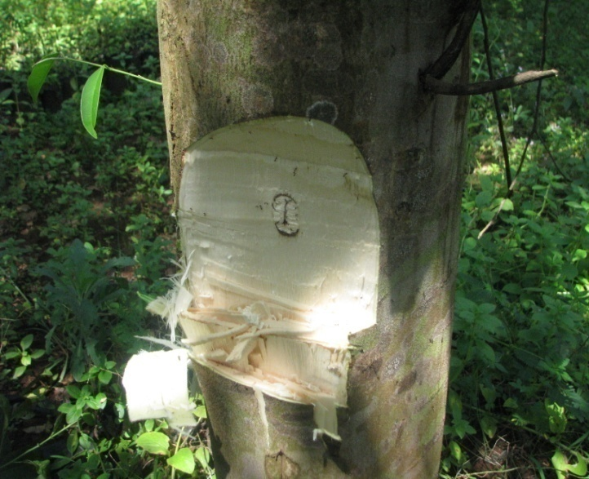
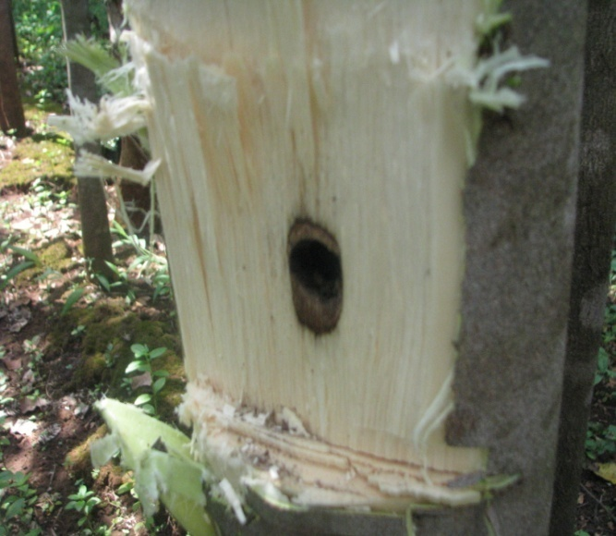
Agarwood impact
Drill a hole and chemical
Acid sunfuric or Sodium metan bisunfit
Drill a hole and fungi
Phialophora sp. and Fusarium sp.
Vietnamese Academy of Forest Sciences (VAFS) www.vafs.gov.vn

Slide 7
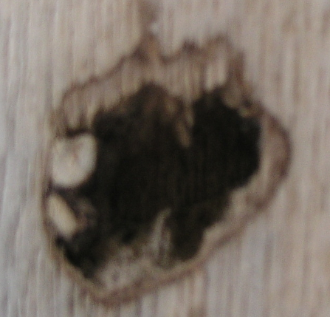
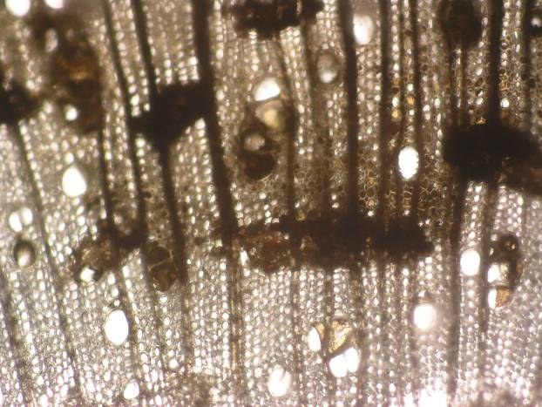
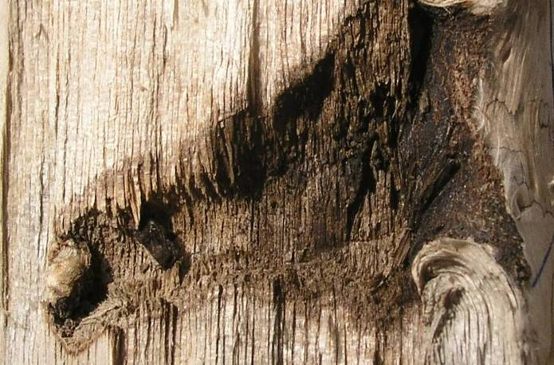
Agarwood anatomy
Regular wood
Agarwood
Vietnamese Academy of Forest Sciences (VAFS) www.vafs.gov.vn

Slide 8
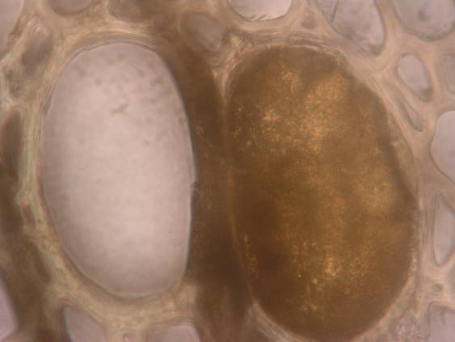
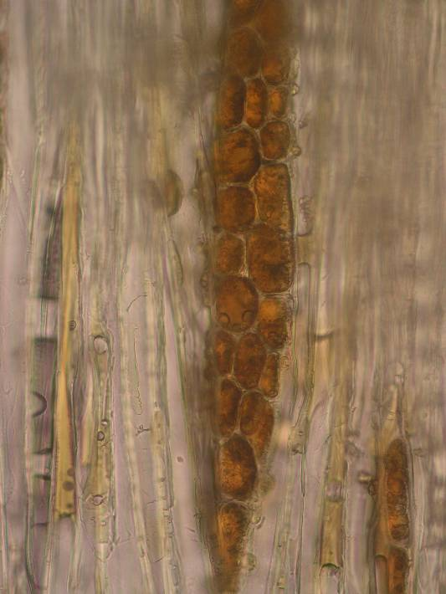
a
c
b
Gums and other deposits in vessels, ray, axial parenchyma
Vietnamese Academy of Forest Sciences (VAFS) www.vafs.gov.vn

Slide 9
Sesquiterpene content after 2 years impact (%)
No | Treatments | Trial forest 7 years old | Trial forest 10 years old | Trial forest 13 years old
1 | Drill a hole + (Phùng Anh) preparation | 4,32 | 8,17 | 20,94
2 | Drill a hole + (KHCN Bình Phước) preparation | 19,31 | 28,78 | 40,58
3 | Drill a hole + (Dó bầu hương) preparation | 12,89 | 19,76 | 27,59
4 | Drill a hole + (Lâm Viên) preparation | 13,87 | 19,04 | 44,18
5 | Drill a hole + (Hồng Ngọc) preparation | 15,54 | 21,37 | 29,17
6 | Drill a hole + (Sơn Thủy) preparation | 5,05 | 6,89 | 22,95
7 | Drill a hole + (Huỳnh Trìu 1) preparation | 14,85 | 17,59 | 19,06
8 | Drill a hole + (Huỳnh Trìu 2) preparation | 8,96 | 10,78 | 12,11
9 | Drill a hole + (Dự án Rừng Mưa) preparation | 10,74 | 14,67 | 25,67
10 | Drive a nail into the tree (nail 10cm) | 3,58 | 4,69 | 7,37
11 | Drill a hole, no preparation | 5,78 | 7,19 | 10,04
12 | Control (no hole, no preparation) | 3,16 | 6,23 | 6,96
Vietnamese Academy of Forest Sciences (VAFS) www.vafs.gov.vn

Slide 10
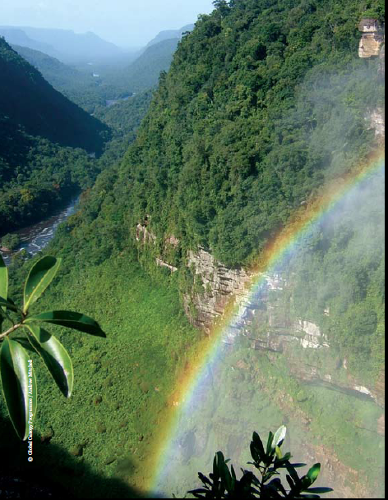
Thank you
Vietnamese Academy of Forest Science
Tel.: 844 38389 031
Fax.: 844 38389 722
Web: www.vafs.gov.vn

